Slide 1
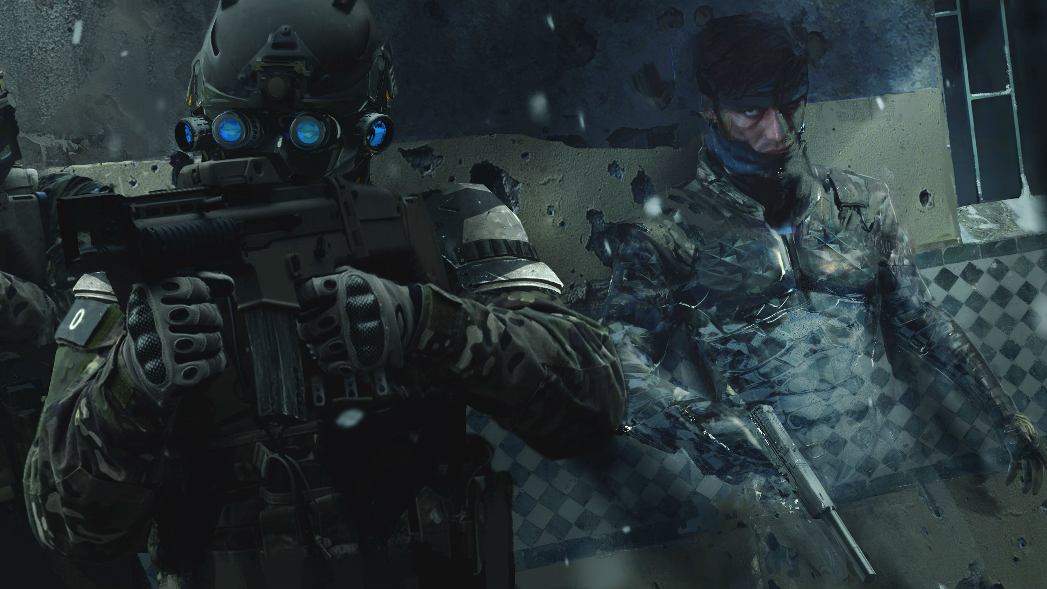
METAL GEAR SOLID 4
GUNS OF THE PATRIOTS

Slide 2
Introduction

Slide 3
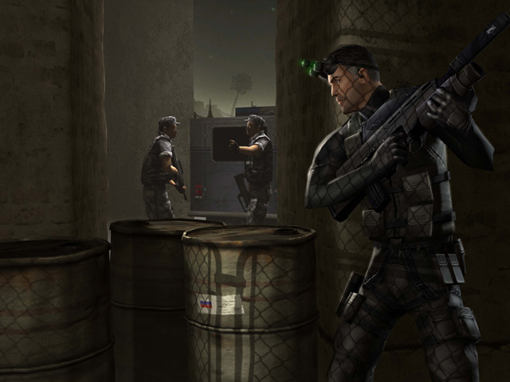
Concept
Third person stealth-action game
Play as the legendary soldier Snake, who use stealth techniques to succeed in his last mission by infiltrating trough a battlefield with the latest technology. The objective is to prevent private military companies from controlling wars and information with AI and nano-machines.

Slide 4
Game identity
Platforms: Console Sony PS3
Camera: Third person
Genre: Stealth-Action
Target: Action-Mastery (Quantic foundry model)
Modes: Solo - Multiplayer
Market place: Japan, Europe, North America
Competitors: Hitman, Splinter Cell, Tenchu, Assassin’s Creed
Art style: Military - Realistic
Themes: War - Technology - Espionage
Business model: Premium

Slide 5
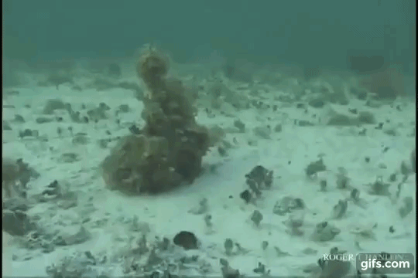
Key Selling Points
A cocktail of stealth and action
Variety of stealth techniques (Crouching, lying down, close combat, decoying, playing dead, taking cover…)
Octocamo (new camouflage technology)
Stealth on a battlefield (new environment)
Make alliance on the battlefield
Cinematographic experience trough high quality cutscenes

Slide 6
Game pillars
A great cinematographic show
A wide variety of stealth approaches
Accessibility (the metal gear solid, the most accessible and the least rigid)
Infiltration in a dynamic battlefield

Slide 7
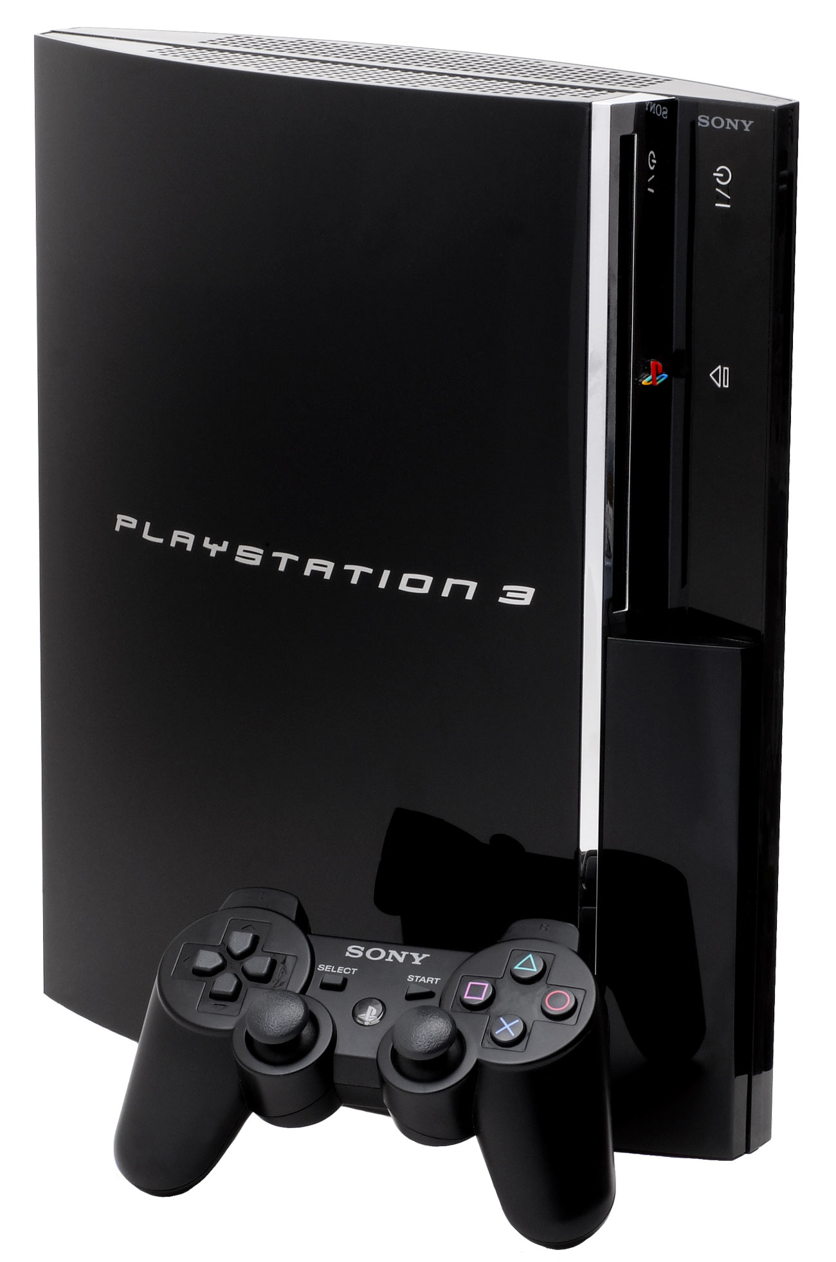
Market place
Stealth games have been selling very well over the last few years
With great title like Splinter Cell, Hitman, Tenchu, and our Metal Gear Solid 3
Opportunity :
Technological showcase for the PS3 with the Octocamo and great cutscenes
To explore
New possibilities with multiplayer modes (player retention on the long run)
Be the best and complete stealth experience

Slide 8
Background

Slide 9
Theme - Universe
War - Technology - Espionage
In the near future, the world is now fully controlled by private military companies (PMCs) composed by soldier enhanced by nano-machines. Behind all this, a secret society wants to increase its power by controlling the population trough their private information with AI and nano-machines.
Key information
Based on Metal Gear Solid Universe
Old snake vs Liquid ocelot
Emphasizing the notion of sacrifice

Slide 10
Main protagonists
Allies
Enemies
Old Snake : the player
Otacon
Drebin : the weapon dealer
Raiden
Meryl
Roy campbell
Big Mama
Liquid ocelot : great enemy
SMP : Soldiers of private military companies
Vamp
Screaming Mantis
Laughing Octopus
Crying Wolf
Raging Raven
The mercenaries :
Can be either allies or enemies depending on your actions

Slide 11
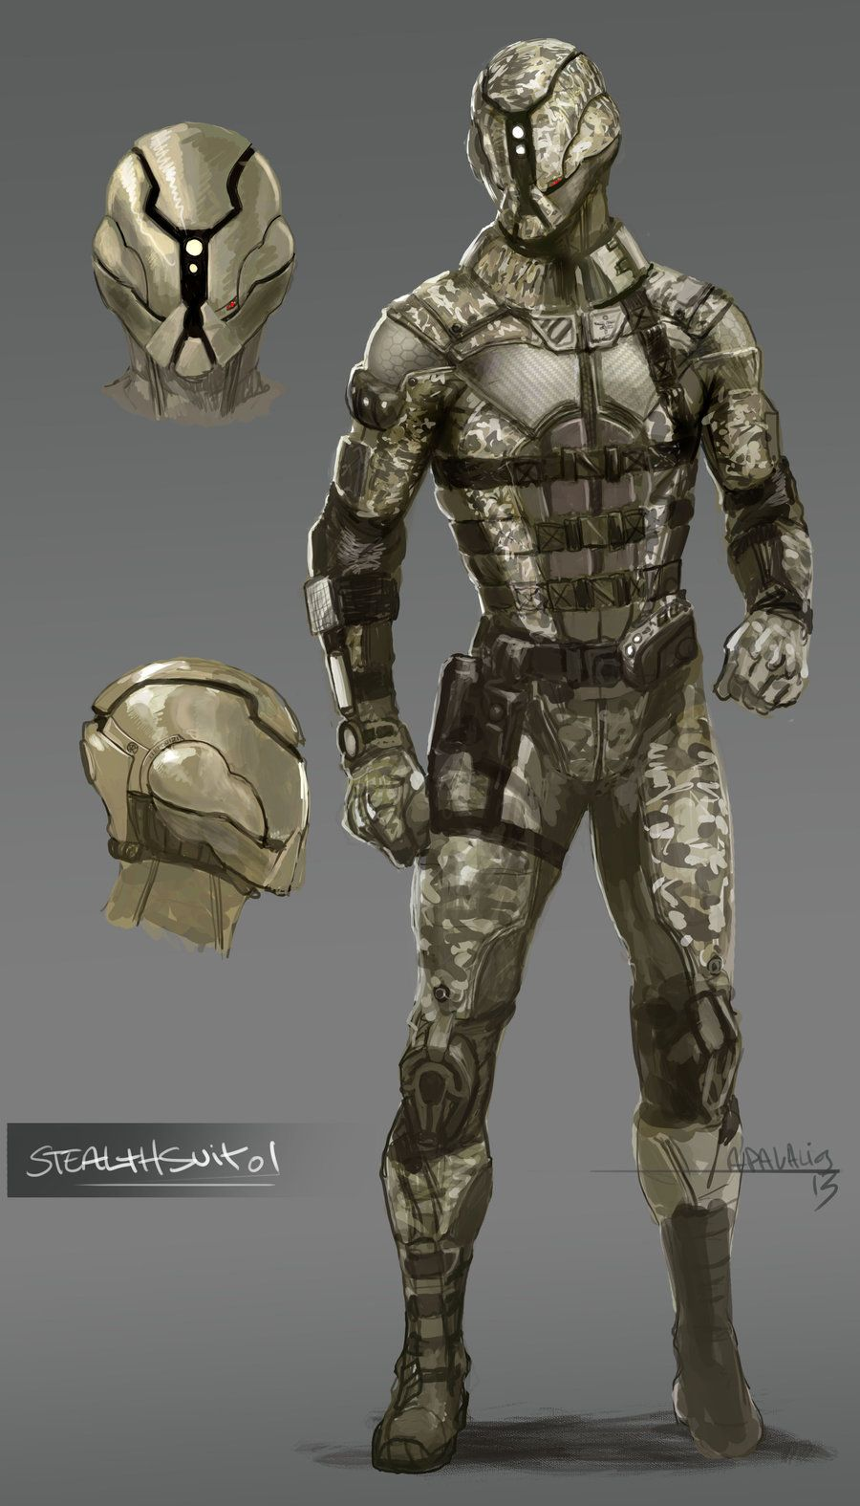
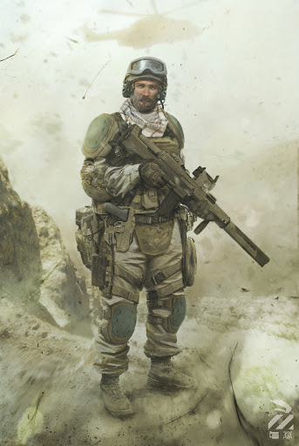
Art style
Realistic 3D game
Military mood
Battlefield
Futuristic equipment

Slide 12
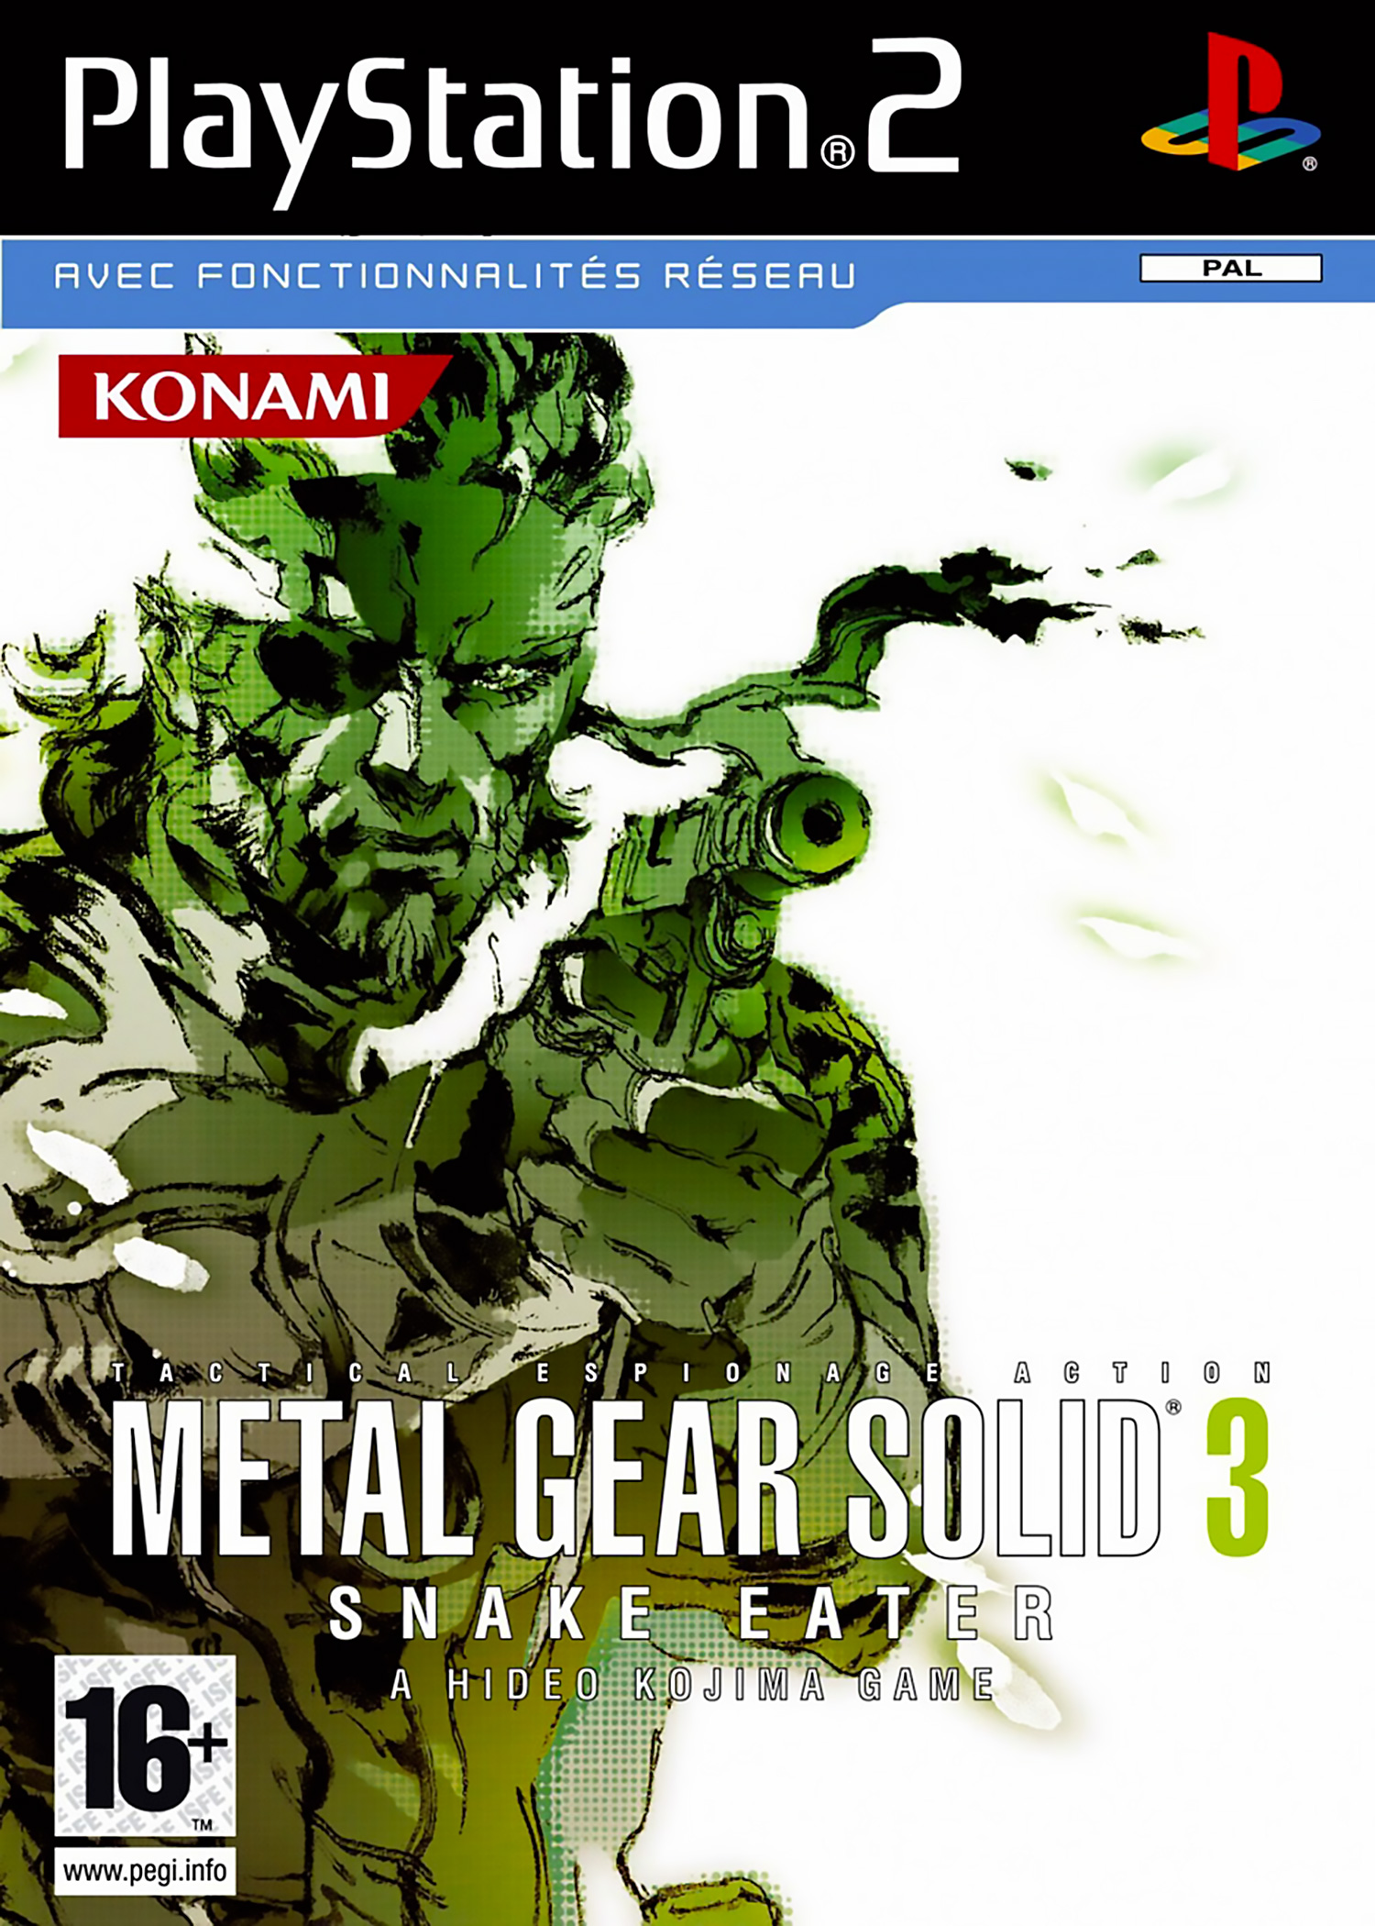
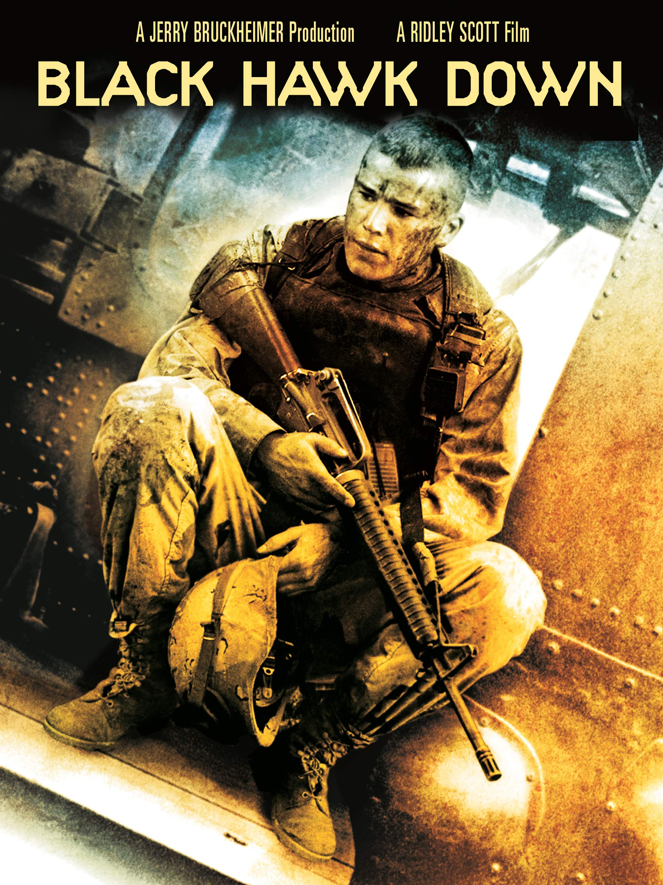
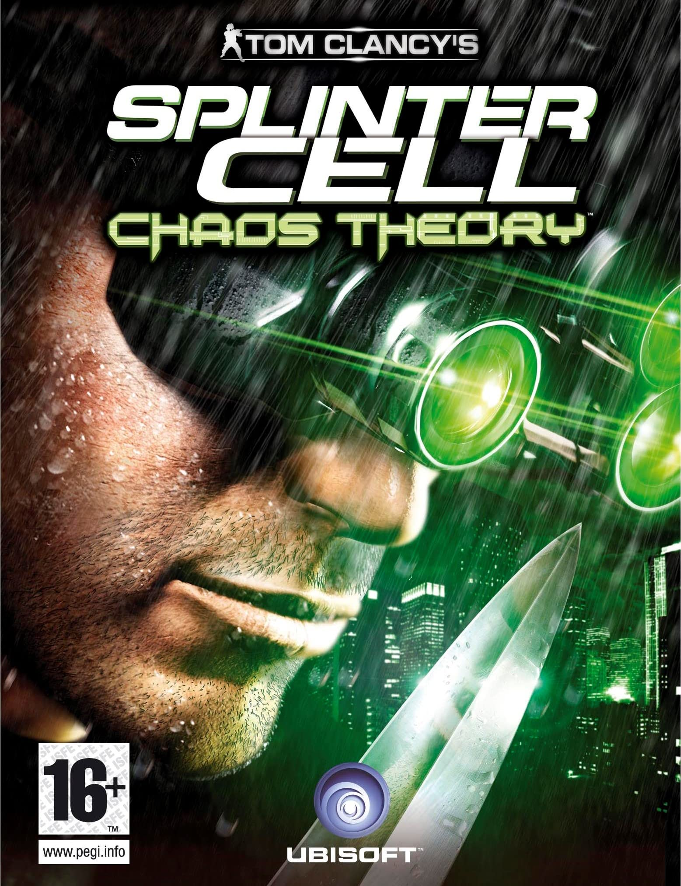
References
Realistic stealth games
Metal Gear Solid 3
Splinter Cell
Movies
Heat (realistic guns fight)
Black hawk down (Military mood and ton)
James bond series – Goldfinger (Espionage, action)
Predator (Camouflage - octocamo)
Planet of the apes (anti-war stance)
Full metal jacket (sniper wolf scene inspired)
Realistic guns fight
Military mood and ton
Espionage - Action
Camouflage
Anti-car stance
Sniper scene
Evasion

Slide 13
Gameplay

Slide 14
Example of ingredients
Detection zones
Cone of vision of a soldier
Distance from a soldier's hearing
Distance from a soldier's sense of smell
Vision cone of a camera or drone
Environment
Offer different paths
Passing through “mouse holes”
Covers
Alert phases
Structuring and challenging the escape
4 alert phases
Abilities of the character
Several postures available
Several movement speeds
Several types of action possible in the hand-to-hand phase

Slide 15
Goal
Move your Avatar stealthily in the environment to go from point A to point B avoiding detection zones and then progress in the main story.
Mission 1
Cutscene – Story telling
Mission 2
successful mission

Slide 16
Macro progression
Story progression
Mission briefing : Control different cameras, be active
Acts : divide into different highlights within a scenario act
Boss fight
New equipments
Act 1 : introduction + small boss
Act 2 : Boss
Act 3 : Boss
Act 4 : 2 Boss
Act 5 : 2 Boss

Slide 17
Core gameplay
Main gameplay
Stealth
Combat
Escape
Go from point A to point B by avoiding (or neutralizing) the detection zones.
Neutralize enemies.
be out of reach of the detection zones for a certain period of time
Choose the target (mental challenge)
Choosing the best path (mental challenge)
Identify the best hiding place (mental challenge)
Main mechanics/ challenges
Neutralize the target - aim/shoot (physical challenge)
Stealth navigation (physical challenge)
Escape, avoid enemies (physical challenge)
Neutralize the target - close combat attack (physical challenge)

Slide 18
Core loop
Phase 1
Phase 2
Phase 3
Succeed in avoiding (or neutralizing) detection zones
Neutral state, no alert
Analysis of the environment, taking information and definition of the best stealth path
Moving forward in the main story
+ new equipment
Alerts triggered
succeed in escaping enemy detection for a given time

Slide 19
3C
Character
Be a legendary soldier, master of infiltration and military combat techniques.
Abilities
Close-quarters combat techniques to silently neutralize an enemy.
Use of firearms
Camouflage : Octocamo
Stealthy navigation : crawling, crouching, silent walk, take cover, suspend, roll over, hide
Camera
The player must feel in control of his or her environment like a skilled soldier.
Third person camera
Free control of the camera for the player
Wide shot camera (see the entire character body)
Adaptative camera in close environment (by zooming on the character)
Control
Supported by the new PS3 controller
Feeling free on the movements of the characters and the camera (left stick for character movement and right stick for the camera control)
Character movement relative to the camera direction
Intuitive controls (e.g., quick change of equipment)

Slide 20
Monetization

Slide 21
Monetization
Business model
Premium
Player Retention Strategy
Mode online
Tactical competitive modes 6 vs 6
Team play and social features
Creating team and regular tournaments
Maps, new characters and equipment to buy (DLC’s)
Based on the Metal gear solid 4 universe and gameplay

Slide 22
Mock up

Slide 23
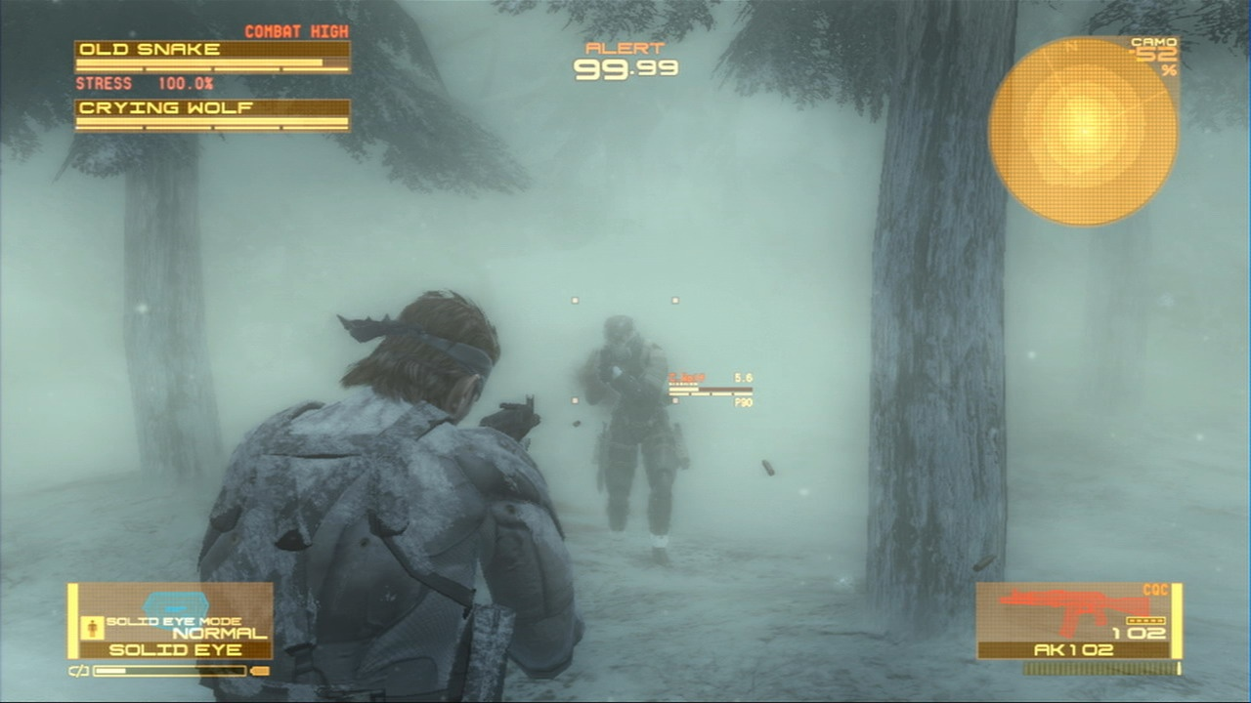
Mock-up – Wide shot camera
Map
Old snake
Indication if on alert phase
Map
Life
Life
energy
energy
energy
energy
Camo
10%
Real-time camouflage effectiveness
Energy (stamina)
Enemy
Indications
The player : Old snake
Equipment
Weapon equipped
Equipment
Weapons
Ammo
Ammo

Slide 24
Mock-up – aim and shoot action
Old snake
Indication if on alert phase
Map
Life
energy
energy
energy
energy
Camo
10%
Targeting reticule
Equipment
Weapons
Ammo

Slide 25
Mock-up – Stealth cover action
Cover
Map
Old snake
Indication if on alert phase
Life
Detection range
energy
energy
energy
energy
Camo
60%
Equipment
Weapons
Ammo

Slide 26
Mock-up – Aim and shoot
Map
Old snake
Indication if on alert phase
Life
energy
energy
energy
energy
Camo
60%
Equipment
Weapons
Ammo

Slide 27
Thanks
And be creative

Slide 28
More details

Slide 29
Tactical movements
To be in total control of one's environment and of one's person
3 Types of posture
3 Movement speed for each posture
Very slow : makes no noise at the sacrifice of speed.
Middle speed : a little more speed and a little more noise
Max speed : maximum speed but also a maximum of noise
Other possible actions
Playing dead while lying down
Rolling from a standing or crouching position to dodge or pass obstacles
Rolling on the ground to cross an area quickly and stealthily
Back and side dodge
Being able to hang on a ledge
Stand up
Crouching
Lying

Slide 30
CQC techniques overview
To be in total control
K.O.
Choke
project on the ground
Stealth approach
kill
Grab the enemy
Use as a shield
Drag
Ground control technique : bring the enemy to the ground
Knock out
Disarm
Freeze : threatens the enemy who raises his hands. It is then possible to steal the enemy's equipment

Slide 31
Octocamo
Use your environment
Dynamic and automatic camouflage
Allows almost instantly to reproduce the color and texture of the environment on which the player is playing.
You must be in cover mode or lying on the ground and wait 1 second to activate the camouflage.
Information about the effectiveness of the camouflage is conveyed to the gambler via a percentage displayed on the HUD.
The higher the percentage, the more invisible the gambler seems to be to enemies.

Slide 32
Main rule – Alert phases
If the player fails in the challenge which is to avoid the detection zones, then an alert is triggered.
There are 4 alert states represented by a counter, when the counter reaches zero, the alert goes to the next phase
Watch out for the signs on the enemies that give you indications
Suspect
Spotted
Normal phase
Alert phase
Evasion phase
Caution phase
Enemy is unaware of the presence of snake
The enemy spotted snake and attack him
The enemy has lost track of snake and is looking for him
The enemy has abandoned the search but remains on guard
Alert
99 seconds
Evasion
60 seconds
Caution
41 seconds

Slide 33
What’s important for us
To provide a maximum of possibilities and depth on our main axes
Stealthy movements
Attacks and close quarters combat techniques
Provide several possible and varied infiltration paths
Structuring and challenging the player's escape when he is spotted
A story full of twists and turns and which encourages reflection on wars

Slide 34
Thanks Again

